Slide 1
Medusa: Simplified Graph Processing on GPUs
Jianlong zhong, Bingsheng he
Presented By: amini, haghighi, fotovat

Slide 2
Content
Abstract
Introduction
Previous works
Medusa
Medusa on Multi GPU
Evaluation

Slide 3
Novelty
A software framework (Medusa)
Simplify programming graph processing on GPU
Provides a set of APIs
Automatically execute user defined APIs in parallel
Hide complexity of programming from developers
Novel graph programming model
Edge-message-vertex
Fine grained processing on vertices and edges
Fitted for parallel graph processing on GPU

Slide 4
Evaluation
Machine with
four C2050 GPU
Two E5645 CPU
Cpu-based implementation based on MultiThread Graph Library

Slide 5
Results
Significant reduction in source code lines
Improved performance of graph processing due
Optimization techniques on
graph layout
Message buffering
1.8 and 2.6 speedup for executing BFS and page rank on four GPU

Slide 6
Goals
Programmability
Highly programmable graph processing framework for different apps.

Slide 7
Introduction
Graphs are common data structure
Social network
Web link analysis
Due to high performance of the entire system, graph processing efficiency is a must
Productivity can greatly improve
Programming framework
High programmability for various graph processing apps.
Providing high efficiency

Slide 8
Introduction (contd.)
GPU as an accelerator for various graph processing apps.
GPU-based solutions vs CPU-based
Improved performance
Limited to specific graph operations
Usually need to implement and optimize programs from scratch for different graph processing tasks.

Slide 9
Introduction (contd.)
GPU programming challenge
Correctness
Efficiency of program

Slide 10
Introduction (contd.)
Many-core processor
Massive thread parallelism
Need to write parallel program which scale to hundreds of cores
Lightweight threads
Fine grained tasks in algorithm
Different memory hierarchy
Explicitly memory management

Slide 11
Pre. work
MTGL
Set of APIs for parallel graph processing on Multi Core CPU
SNAP framework
Set of algorithms and building blocks
Bulk Synchronous Parallel
Local computation perform on vertices
Vertices able to exchange data

Slide 12
Bulk Synchronous Parallel
Consist of
Components with processing/local memory transaction
Network that routes messages between components
Hardware allow for Synchronization
Each processor
fast local memory
Communication network

Slide 13
Bulk Synchronous Parallel (contd.)
A computation proceeds in a series of global steps
Each step has
Concurrent computation
Communications
Barrier synchronization
Google adopt this for graph processing
Pregel
Mapreduce

Slide 14
GPU
Each GPU array of Streaming Multiprocessor (SM)
Each SM a group of scalar cores
CUDA enable developers to run hundred of GPU cores with thousand of threads
CUDA memory hierarchy
Shared memory -> low latency
Device memory

Slide 15
Assumptions
Graph is directed
Each vertex has unique ID ranging [0..V-1]
Each associated edge with same vertex has ID ranging [0..d-1]
d is out degree of vertex
d_{max} is maximum out degree in graph

Slide 16
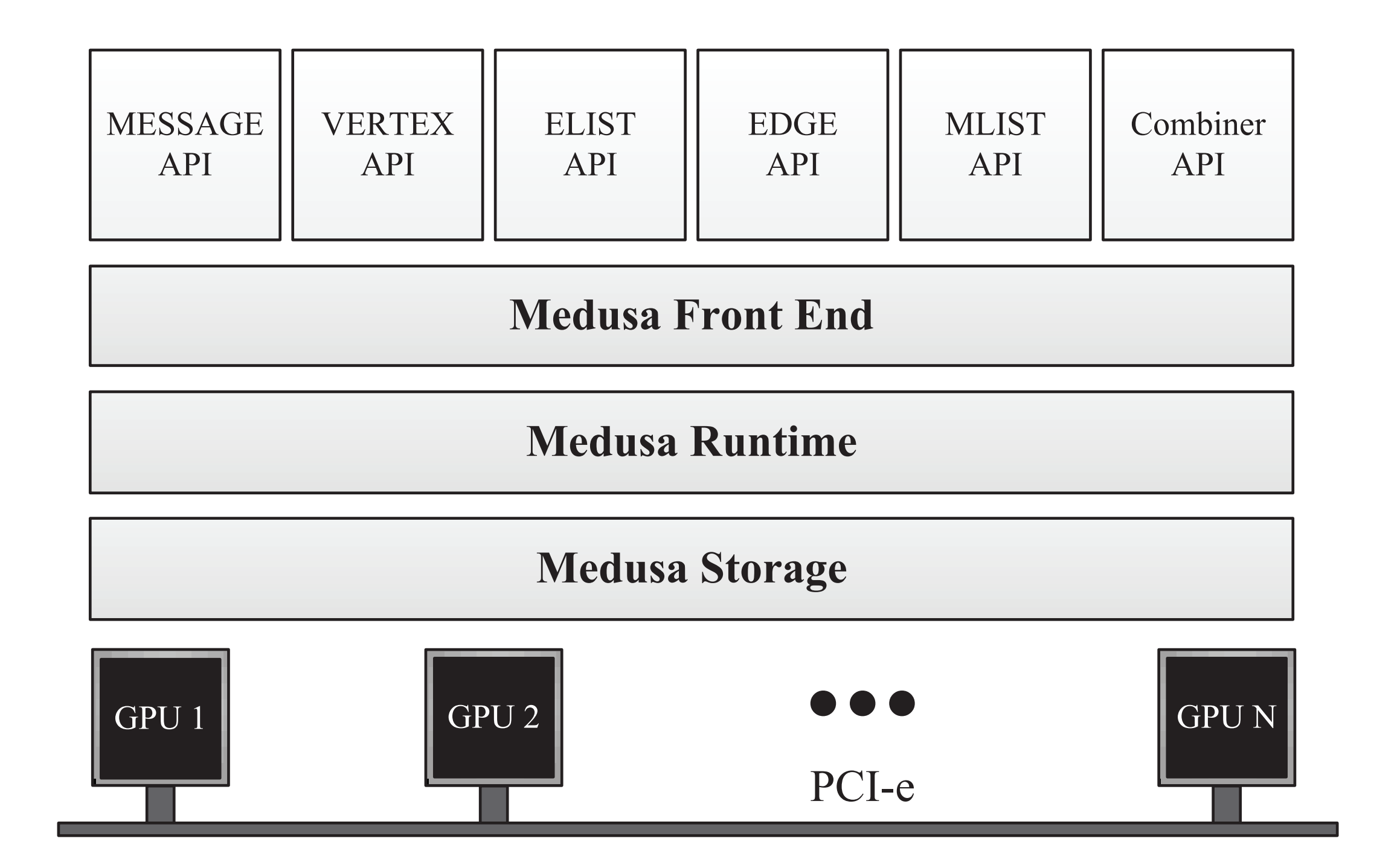
Overview of Medusa

Slide 17
Medusa Workflow
Define basic structures → edge, message and vertex
Application logic → EMV APIs
Composes the main program
initializing the graph structure
Configuring the framework parameters
invoking the customized EMV APIs with the system provided APIs

Slide 18
Iteration Control
maxIteration
terminates when the number of iterations reaches the predefined limit
halt flag
Global variable
modified by the EMV APIs
initializing halt as false

Slide 19
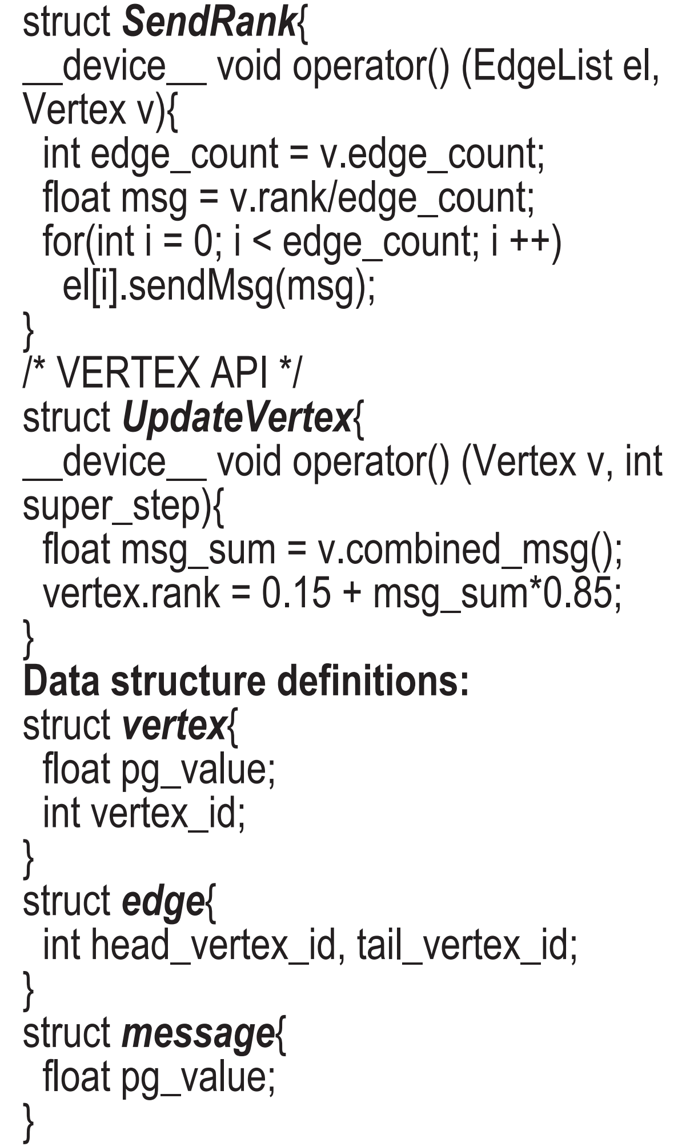
Sample Code(Part-1)

Slide 20
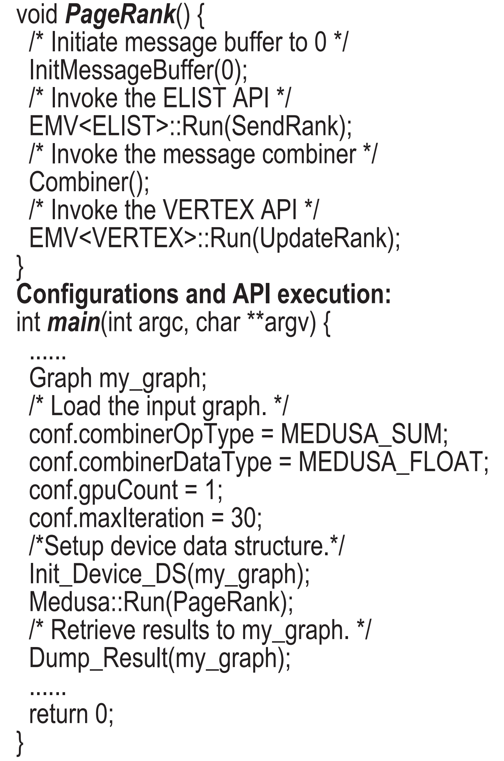
Sample Code(Part-2)

Slide 21
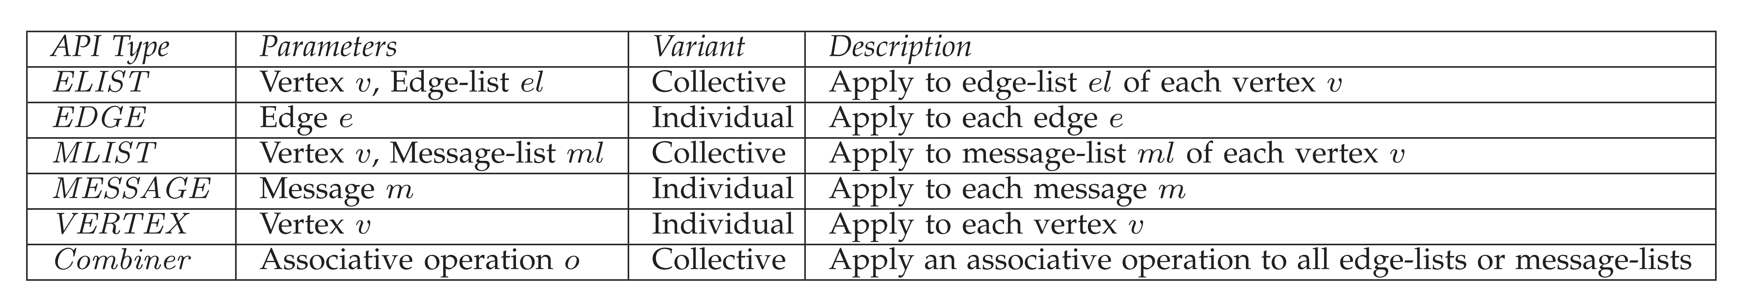
User-defined APIs in EMV

Slide 22
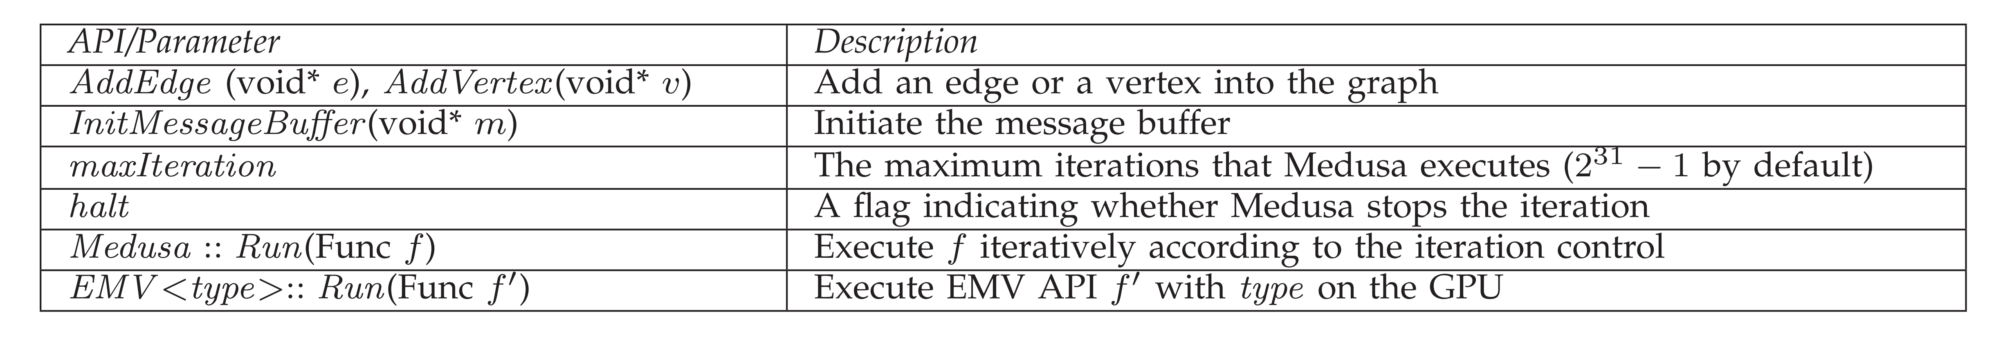
System APIs and Parameters

Slide 23
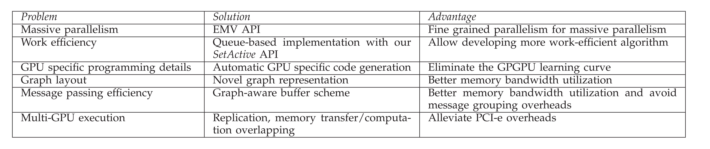
Techniques used in Medusa

Slide 24
Massive Parallelism
Vertex-based API problems
different vertices →different numbers of edges→ different workloads on each API instance.
different number of received messages →divergence.
EMV
individual vertices, edges or messages
Each GPU thread → one instance of the user-defined API
Collective & individual

Slide 25
Work Efficiency
Medusa Default
applies the user-defined API on the vertices/edges on the entire graph
SetActive API
Dynamic queue
apply the EMV APIs to the active vertices and edges only

Slide 26
Message Passing Efficiency
Fixed-Size Array
Information of the buffer size
Output position
Need Grouping Operation
Dynamic List
No pre-computation
No grouping operation
Need atomic operation

Slide 27
Message Passing Efficiency
EMV→ sent/received along the edge
Set maximum number of messages
the maximum total number of messages
the maximum number of messages that each vertex can receive
Avoid the grouping operation
reversed edge indexed message passing
Write positions→ consecutive

Slide 28
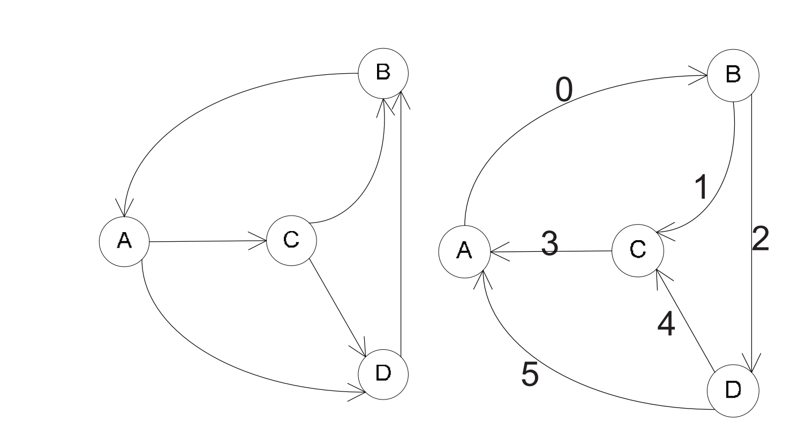
Reversed Edge Indexed

Slide 29
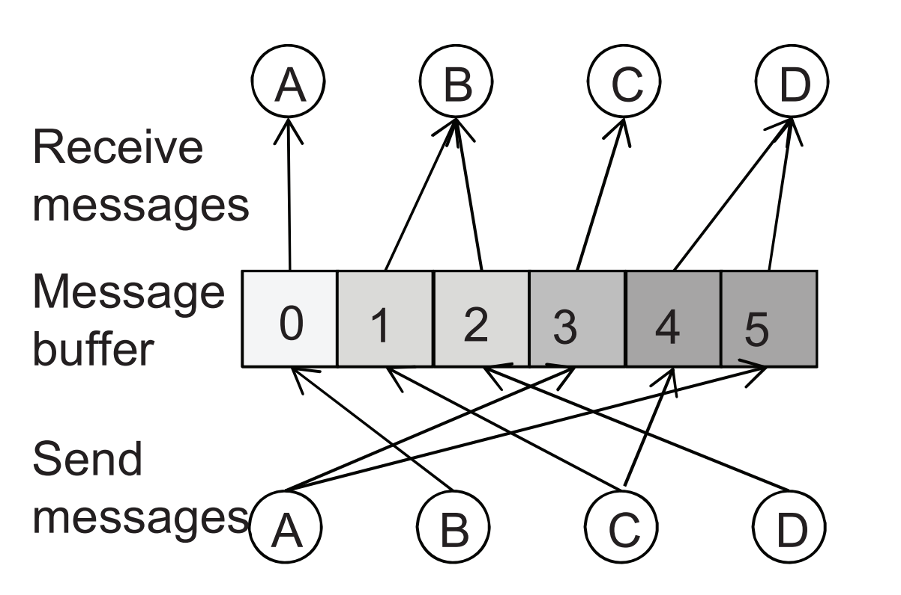
Reversed Edge Indexed

Slide 30
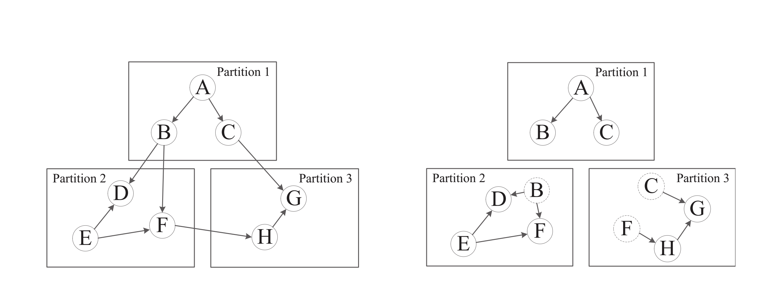
Multi-GPU Execution (Replication)

Slide 31
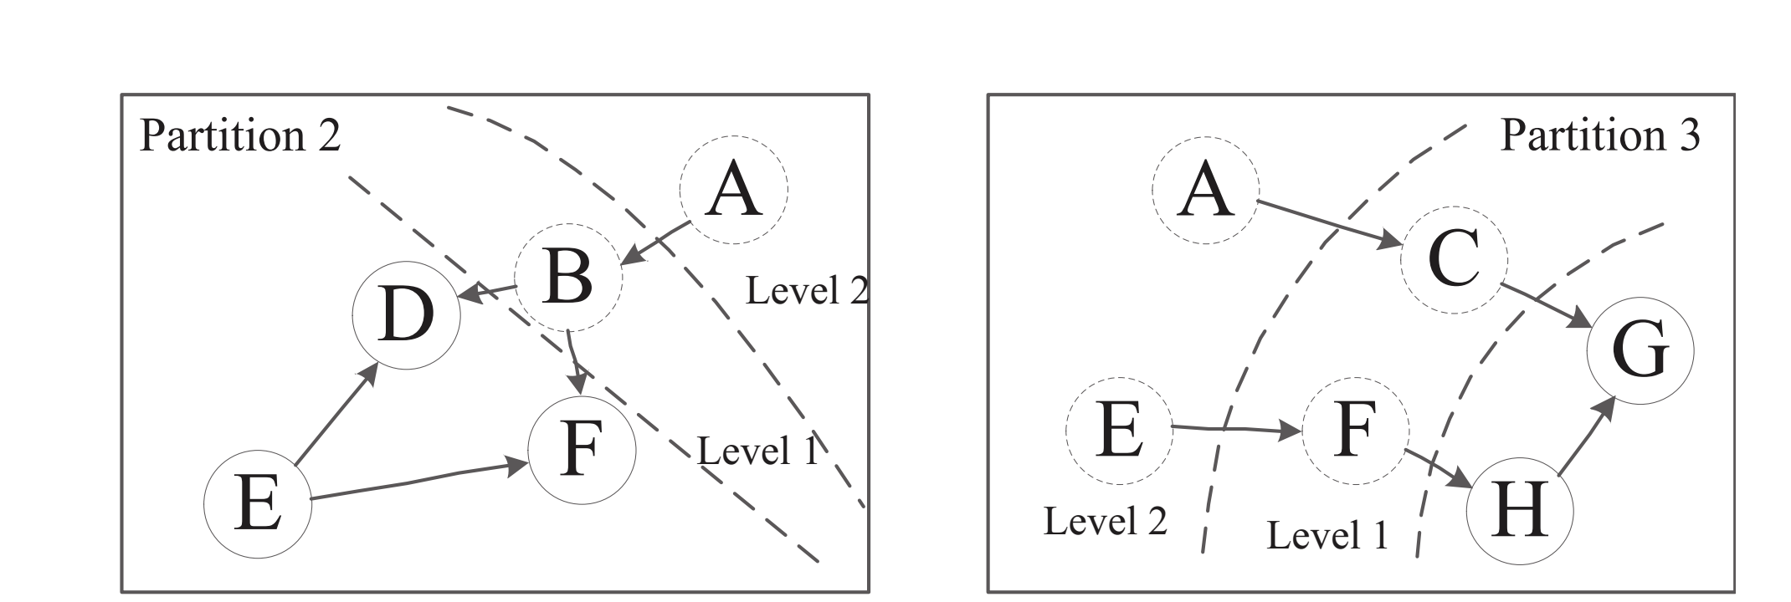
Multi-GPU Execution (Multi-hop)

Slide 32
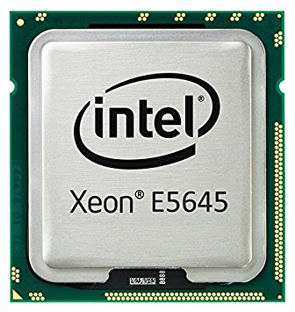
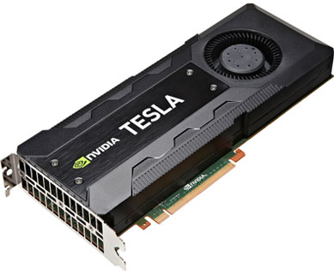
Evaluation
Workstation specs:
NVIDIA Tesla C2050
2× Intel Xeon E5645 2.4GHz
24 GB Ram
Common Graph Processing Operations
PageRank
Maximum Barpartite Matching (MBM)
Breadth First Search (BFS)
Single Source Shortest Path (SSSP)

Slide 33
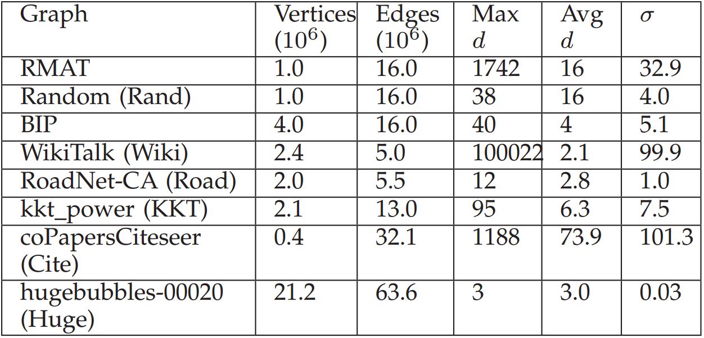
Evaluation (Cont’d)
Graph Categories
Real-World
Synthetic

Slide 34



Comparison
Medusa Vs Manual Implementation
Two Approaches
Queue-based ( -Q)
Non Queue-based ( -N)

Slide 35
TEPS
What is TEPS?
Traversed Edges Per Second
As a metric for Super Computers
TEPS Vs FLOPS
Aims to measure communication capabilities
Source: graph500.org
Wikipedia.org

Slide 36
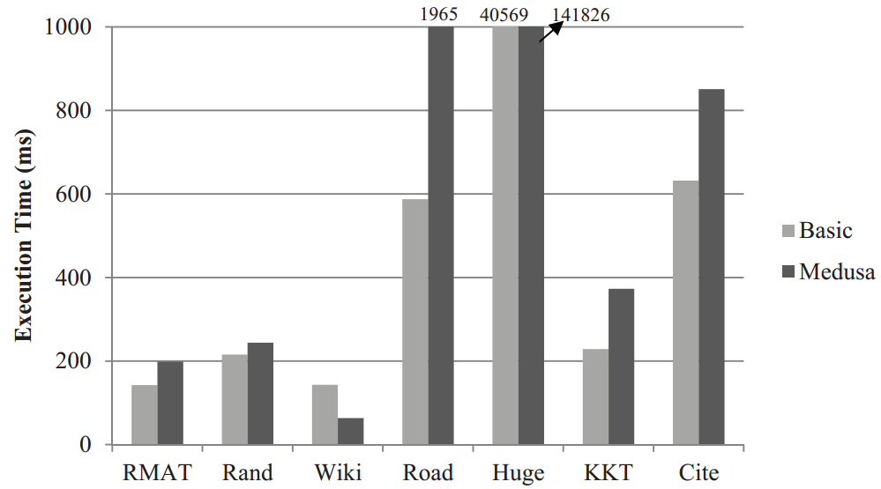
Performance

Slide 37
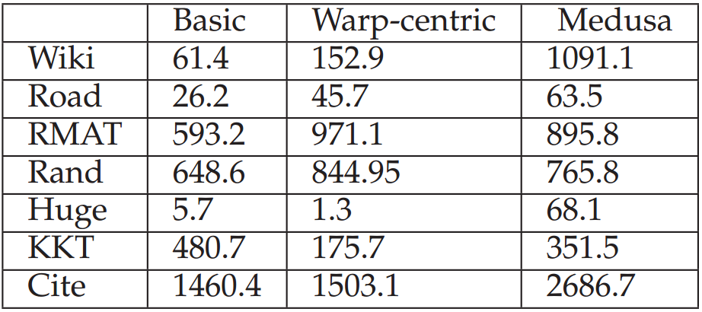
TEPS Comparison

Slide 38
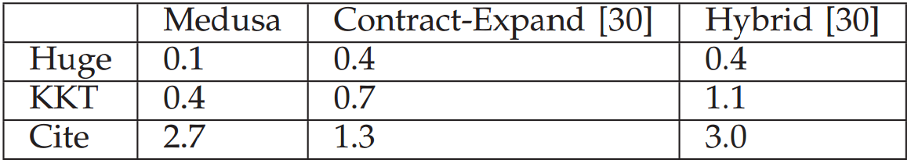
TEPS Comparison (Cont’d)

Slide 39
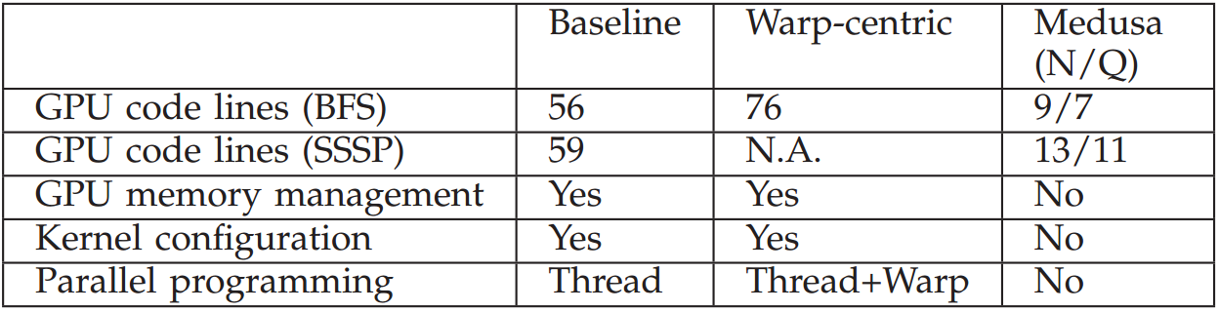
Programmability
Code Complexity
Number of lines!

Slide 40
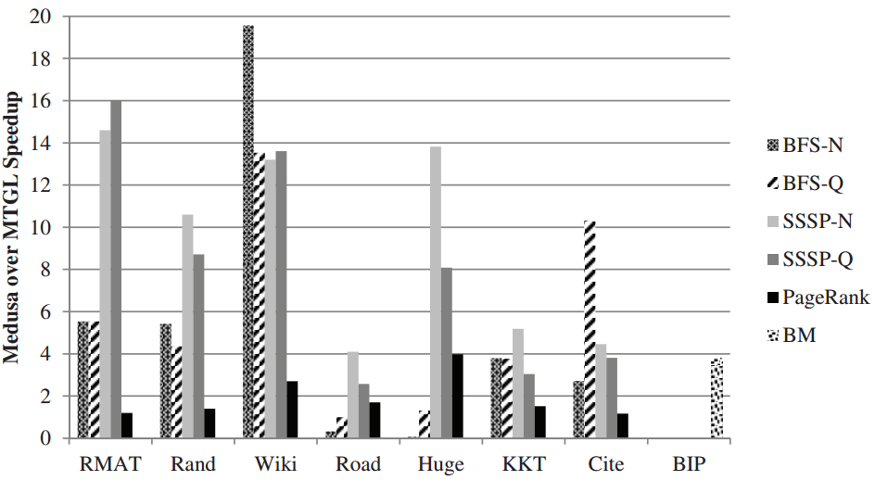
Efficiency
Compare with MTGL
Speedup
MTGL / Medusa

Slide 41
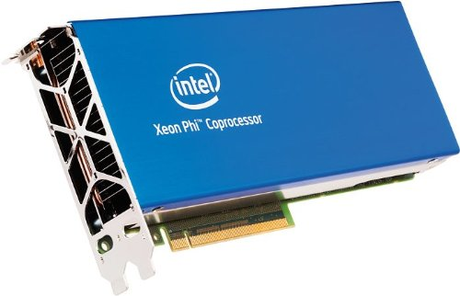

Future Work
Medusa on other architectures like:
Intel Xeon Phi™
Extend Medusa to distributed systems
Automatic decision on dynamic-queue

Slide 42
CONCLUSIONS
New programming framework named Medusa
efficiency and programmability of GPU-based parallel graph processing
hide the programming complexity
only need to write sequential programs

Slide 43


